Slide 1

MicroControllers
Lecture 22 – EEPROM
Spring 2020

Slide 2
Today’s Lecture
Overview
Programming Registers
Programming a write and a read
Read DataSheet – ‘AVR Memories’ : section 12
Exam Review on Zoom – Friday (Attendance is required)
Exam #3 – next Monday
Assignment

Slide 3
Overview

Slide 4
What is EEPROM?
Electrically erasable and programmable read only memory
Nonvolatile data storage
Used to retain data even when power is removed or chip is reset
1KBytes of storage available on ATmega328
Writes and reads are done through registers (big surprise)
Can be rewritten reliably 100,000 times
What might you save in an EEPROM?

Slide 5
Limitations of ATmega328 EEPROM
Only 1Kbytes
Limited write lifetime
11 years if you write once per hour
69.5 days if you write once per minute
28 hours if you write once per second
Ergo: EEPROM not a good choice if you need to constantly save data
Writing and reading are cumbersome

Slide 6
EEPROM Layout
Address (10 bits) | Data (8 bits)
0
1
2
:
:
:
:
1022
1023

Slide 7
Programming Registers

Slide 8
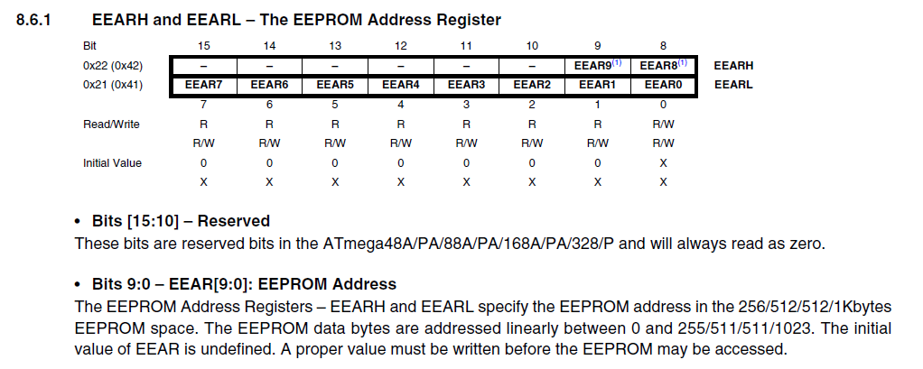
EEPROM Address Register
When you want to write to or read from the EEPROM, you put the address of the location in the EEAR register.
Even though it is 16 bits, you only have to use one instruction
EEAR = <address>

Slide 9
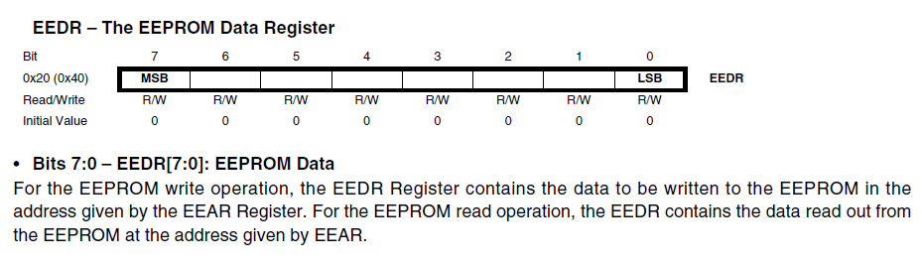
EEPROM Data Register
Data is only read or written 8 bits at a time

Slide 10
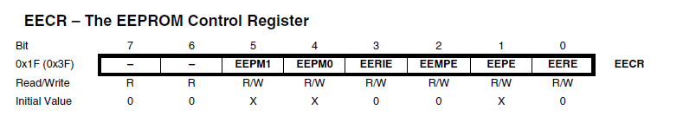
EEPROM Control Register
This is where it gets complicated

Slide 11
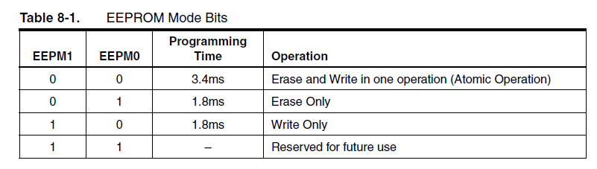
EEPROM Control Register
Why the different options here?

Slide 12
EEPROM Control Register
Write enables – EEMPE and EEPE
For a write
First set EEMPE to 1 while EEPE is 0
Within 4 clock cycles (so make it the next instruction) set EEPE to 1
If EEMPE is 0, EEPE has no effect
EEMPE and EEPE are both cleared to 0 by hardware after write

Slide 13
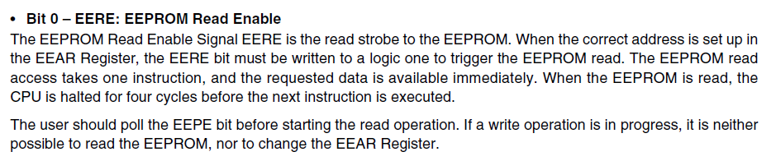
EEPROM Control Register
Read Enable

Slide 14
EEPROM Control Register
Interrupt Control
Writing a 1 to EERIE enables the EEPROM ready interrupt
When EEPE is cleared after the write, the interrupt is triggered
Because the interrupt is constantly triggered when EEPE is low, you only want to enable the interrupt when writing a long string of data and then disable it when completed.
In other words, do not enable it in setup() or you will be constantly interrupting.

Slide 15
Programming a write and a read

Slide 16
Write Sequence
Wait for EEPE bit in EECR to be cleared (signifying EEPROM is ready)
Put the address of the location you want to write to in EEAR
Put the data you want to write in EEDR
Set EEMPE to 1 and clear EEPE to 0 in the EECR register
Within four clock cycles, set EEPE to 1 in the EECR register

Slide 17
Write Sequence Note
Steps 4 and 5 of the write sequence must occur within 4 clock cycles or else the EEMPE bit is cleared and no write can occur
As such, it is recommended to turn off all other interrupts while writing to EEPROM

Slide 18
Write function
void EEPROM_write(unsigned int Address, byte Data)
{
/* Wait for completion of previous write. EEPE clears when write completes.*/
while(EECR & 0b00000010) { }
/* Set up address and Data Registers */
EEAR = Address;
EEDR = Data;
cli();
/* Write logical one to EEMPE */
EECR |= 0b00000100;
/* Start EEPROM write by setting EEPE */
EECR |= 0b00000010;
sei();
}

Slide 19
Read Function
byte EEPROM_read(unsigned int Address)
{
/* Wait for completion of previous write. EEPE clears on completion */
while(EECR & 0b00000010) { }
/* Set up address register */
EEAR = Address;
/* Start EEPROM read by writing EERE */
EECR |= 0b00000001;
/* Return data from Data Register */
return EEDR;
}

Slide 20
The End
Thanks for listening
No homework due this week
Mandatory Zoom review class on Friday
Exam #3 in class on Monday

